Slide 1

Serverless Expense Tracker with AWS Quicksight
SRIKANTH (2210030384)
Under the esteemed guidance of
Ms. P. Sree Lakshmi
Assistant Professor,
Department of Computer Science and Engineering

Slide 2
Project Overview
Brief Description of the Problem or Opportunity Manual expense tracking is time-consuming and lacks real-time insights. There's a need for an automated, scalable solution to manage and analyze expenses efficiently using cloud services.
Objective of the Project To build a serverless, cost-effective expense tracking system using Amazon S3 and AWS QuickSight that enables secure storage and dynamic visual dashboards.
Real-world Relevance Ideal for individuals and businesses seeking automated, infrastructure-free solutions for financial monitoring and decision-making.

Slide 3



Services Used
Amazon S3 Used to store raw expense data (expenses.csv) and the manifest.json file for QuickSight integration.
AWS IAM Managed permissions securely by allowing QuickSight access to the S3 bucket using least-privilege policies.
AWS QuickSight Analyzed and visualized expense data using interactive dashboards and built-in analytics tools.

Slide 4
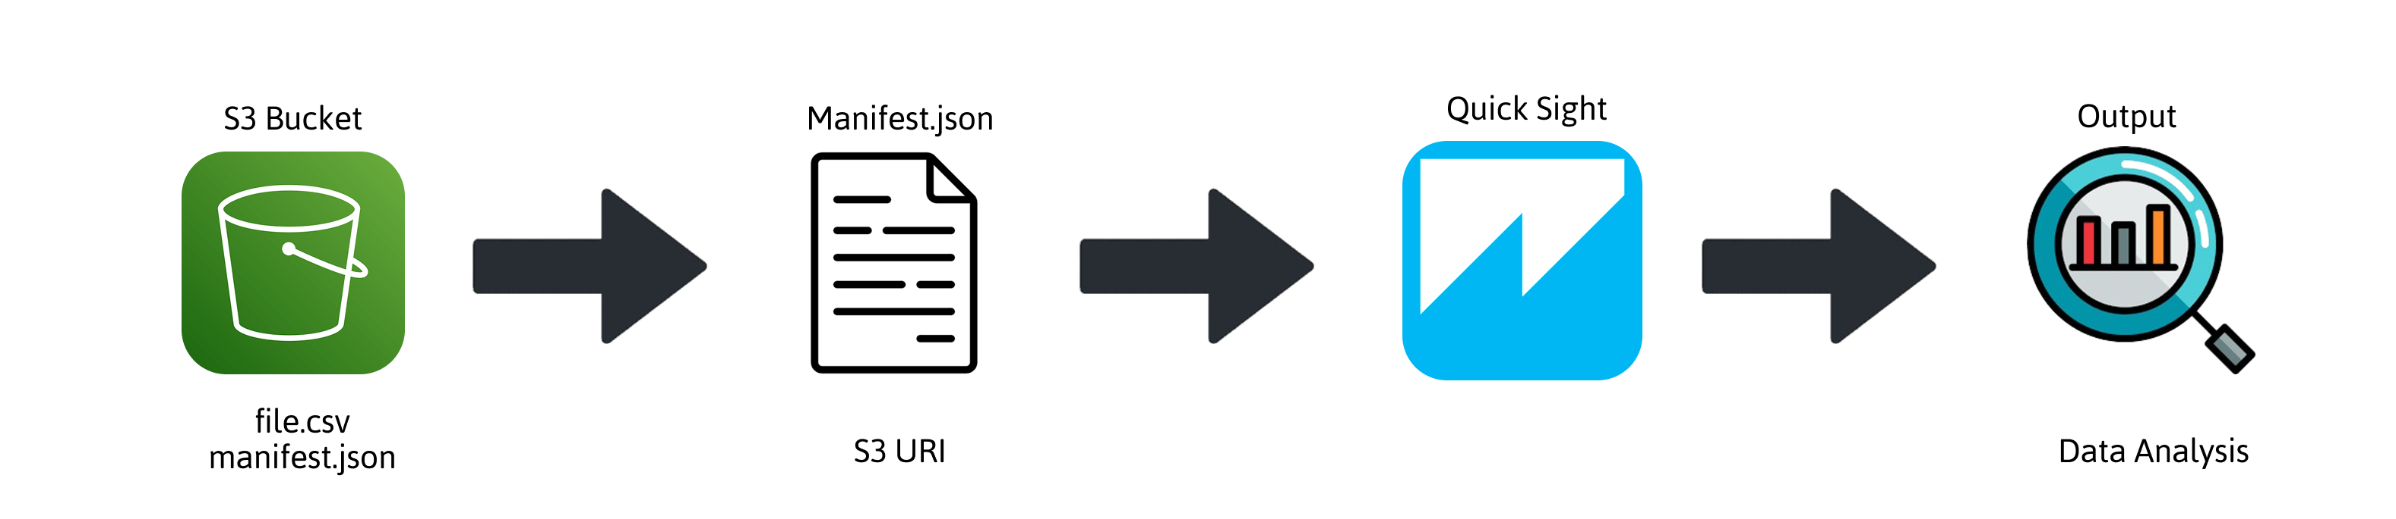
Flow Diagram
User → Amazon S3 Uploads expenses.csv and manifest.json.
Amazon S3 Stores data securely and provides access via manifest file.
AWS IAM Grants QuickSight read-only access to S3.
AWS QuickSight Fetches data and creates visual dashboards.

Slide 5
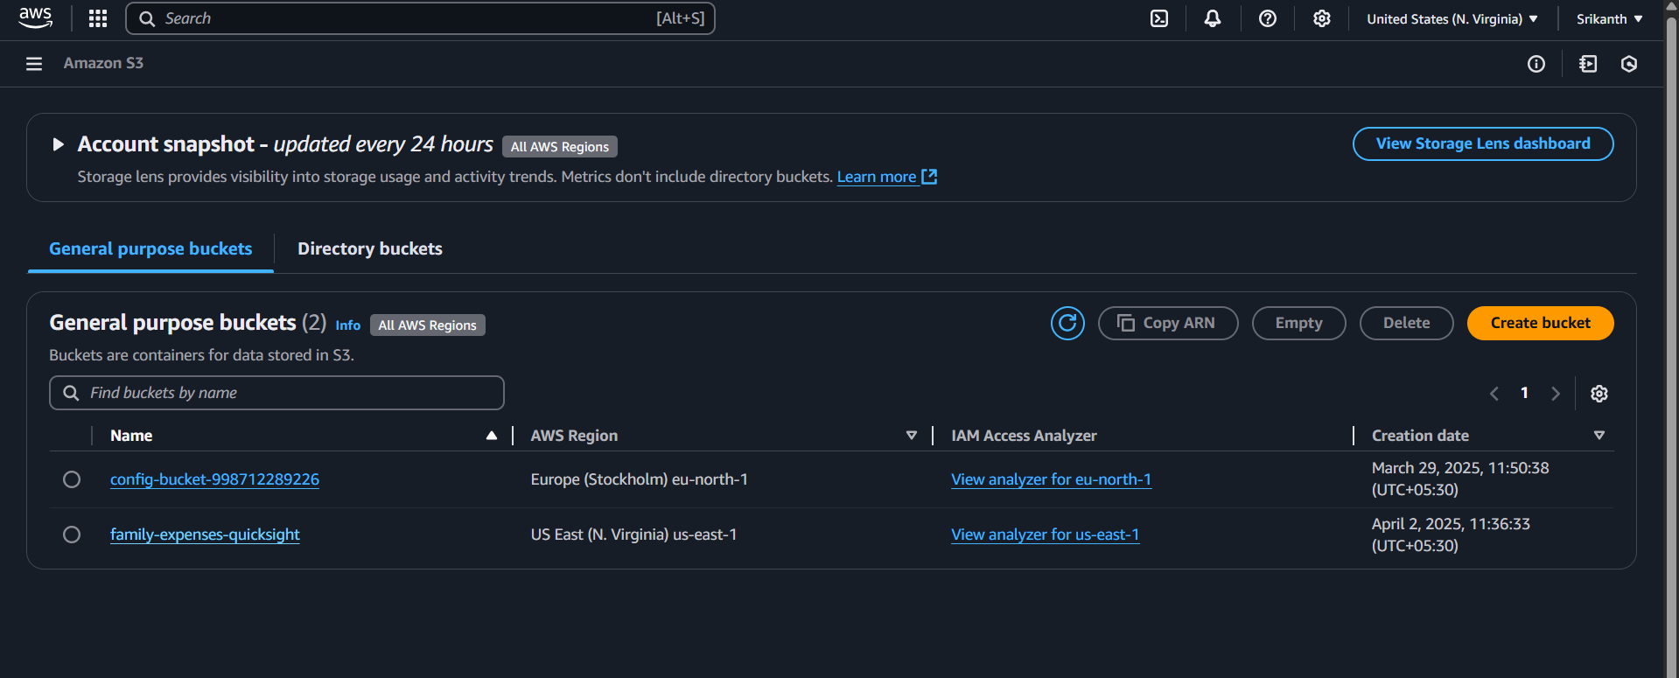
Implementation Process
1: Create S3 Bucket: Go to AWS S3 → Create bucket → Enable encryption & disable public access and Upload the required objects – Dataset and manifest.json.

Slide 6
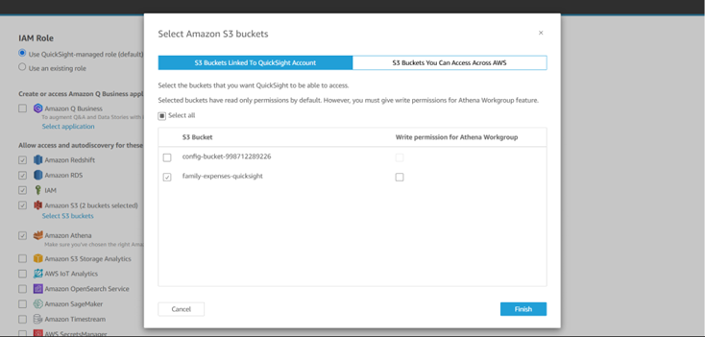
2: Grant QuickSight Access to S3 Open AWS QuickSight → Go to "Manage QuickSight" → Choose "Security & permissions". Add the S3 bucket path to the list of allowed buckets. This allows QuickSight to access and read your uploaded CSV file.

Slide 7
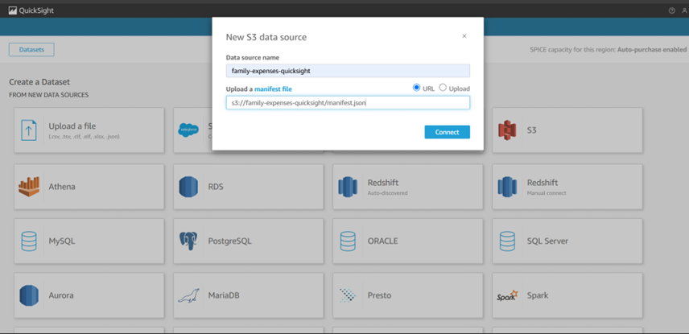
3: Connect Dataset in QuickSight In QuickSight → Go to "Datasets" → Click “New dataset” → Choose "S3" as source. Paste the manifest file URI → QuickSight reads the CSV file schema using the manifest. Click “Edit/Preview data” to validate and prepare your dataset.

Slide 8
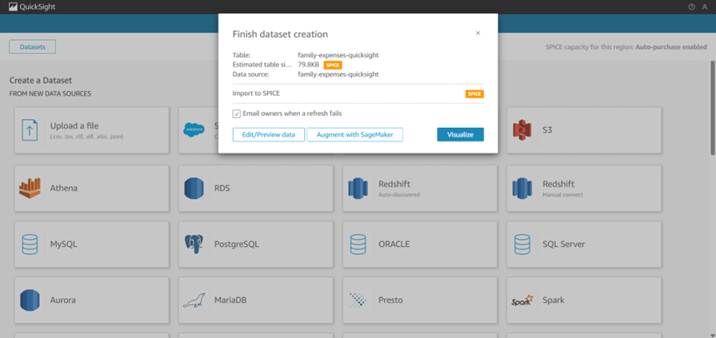
4: Create Visual Dashboard Click “New Analysis” → Select your prepared dataset. Add visual elements like bar charts, tables, and KPIs to analyze expenses by category, date, or amount. Use filters and calculated fields for deeper insights.

Slide 9
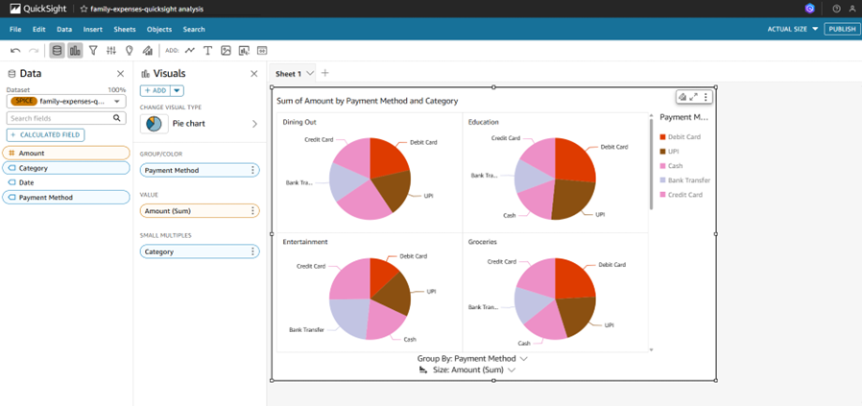
5: Final Outcome You now have a fully serverless, secure, and scalable expense tracking solution. QuickSight provides dynamic, real-time dashboards directly from data stored in S3.

Slide 10
Key Features and Functionality
Major Functionalities & User View
Expense Data Ingestion User uploads expenses.csv and manifest.json to Amazon S3.
IAM-based Secure Access IAM roles ensure QuickSight can access only necessary S3 data.
Data Visualization QuickSight reads data and creates interactive dashboards with filters, charts, and tables.
AWS Services Integration
Amazon S3 → Stores raw and structured data.
AWS IAM → Manages secure, limited access.
AWS QuickSight → Provides real-time analytics and visuals.

Slide 11

Results and Outputs

Slide 12
Challenges and Solutions
Challenge: Configuring QuickSight to read from S3 using a manifest file. Solution: Referred to AWS docs and formatted the manifest JSON correctly.
Challenge: IAM permissions not allowing data access initially. Solution: Used policy simulator to debug and applied least-privilege access.
Challenge: QuickSight not updating after CSV changes. Solution: Refreshed dataset manually and confirmed auto-refresh settings.

Slide 13
Learnings & Takeaways
Technical skills gained:
Amazon S3: Learned secure data storage, access control, and object management.
AWS IAM: Gained hands-on experience creating roles and crafting least-privilege policies.
AWS QuickSight: Built datasets, created dashboards, and understood manifest-based ingestion.
Serverless Architecture: Understood how to integrate AWS services without managing infrastructure.
AWS Management Console: Improved efficiency in navigating and configuring cloud services.

Slide 14
Future Scope
Possible Extensions:
Integrate AWS Lambda for automated CSV validation or transformation.
Add email alerts using SNS for unusual spending patterns.
Real-Time Deployment Ideas:
Using Amazon Kinesis for streaming real-time expense data.
Implement Athena for ad-hoc querying on large datasets.
Cost Optimization & Scaling:
Enable S3 lifecycle rules to transition old data to Glacier.
Choose SPICE capacity wisely in QuickSight for optimal cost-performance.

Slide 15
References
Amazon S3 documentation. https://docs.aws.amazon.com/s3/
IAM documentation. https://docs.aws.amazon.com/iam/
QuickSight User Guide. https://docs.aws.amazon.com/quicksight/
AWS Management Console. https://aws.amazon.com/console/
Serverless Expense Tracker. https://namrata-bhaumik.medium.com/my-aws-adventure-building-a-serverless-expense-tracker-392091e60207
Using manifest files for data ingestion in QuickSight. https://aws.amazon.com/blogs/big-data/
Dataset. http://kaggle.com/datasets/tharunprabu/my-expenses-data
QuickSight visualizations documentation https://docs.aws.amazon.com/quicksight/latest/user/working-with-visual-types.html

Slide 16
THANK YOU

